Slide 1
MICROBES
Viruses & Bacteria

Slide 2
VIRUSES
A. General Characteristics of Viruses
Viruses are infectious agents with both living & nonliving characteristics
They can infect animals, plants, and even other microorganisms
1. Living Characteristics of Viruses
a. They reproduce at a fast rate, but only while in living host cells
b. they can mutate
2. Nonliving Characteristics of Viruses
a. they are acellular → contain no cytoplasm or organelles
b. don’t carry out metabolic activities on their own → must replicate using host cell’s metabolic machinery
c. they possess DNA or RNA, but never both

Slide 3
Criteria to define a virus
A. Contain only one type of nucleic acid, DNA or RNA, but not both
B. They are totally dependent on a host cell for replication (obligate intracellular parasites)
C. Viral components must assemble into complete viruses to go from one host cell to another

Slide 4
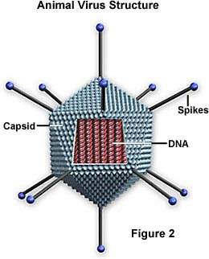
STRUCTURE
1. DNA or RNA core enclosed in a protein coat(capsid)
Genetic material only codes for making copies of the virus… no metabolic processes
2. May have a viral envelope consisting of phospholipids around the capsid
3. No nucleus, cytoplasm, or membranes
4. Smaller than a bacterial cell

Slide 5
FUNCTION
1. obligate intracellular parasites (require a host cell to replicate)
2. do not carry out cellular fxns (ie respiration)
3. do not generate metabolic activity
4. bacteriophage – virus that infects bacteria
T1-T7 are bacteriophages that infect common intestinal bacterium Escherichia coli (E.coli)
5. mycophage – virus that infects fungus

Slide 6
REPLICATION
1. before a virus can enter & replicate in a cell, it has to recognize & attach to a specific receptor site on the plasma membrane of the host cell
2. proteins on the surface of each virus has a 3D shape that matches the shape of a molecule in the plasma membrane of its host cell
3. once attached to the plasma membrane, the virus has to get inside the cell and take over the cell’s metabolism

Slide 7
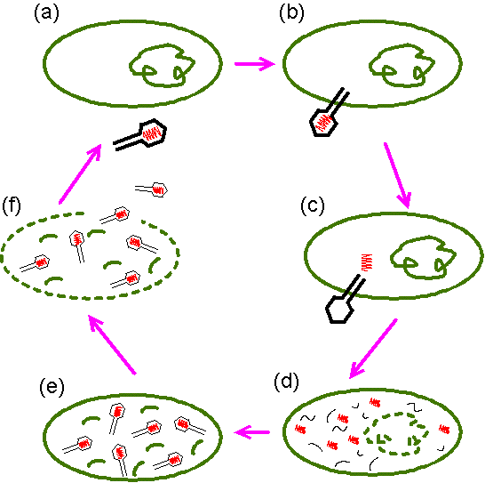
FIND NEW HOST
ATTACHMENT
LYSIS & RELEASE
ENTRY
ASSEMBLY
REPLICATION

Slide 8
LYTIC CYCLE
Lytic Cycle – host cell is destroyed immediately
ATTACHMENT – attach to a host cell
ENTRY – insert genetic material
REPLICATION – destroy host cell DNA/make new virus parts
ASSEMBLY – assemble new virus particles into new viruses
LYSES AND RELEASE – burst host cell to release virus
Attach to a new host cell

Slide 9
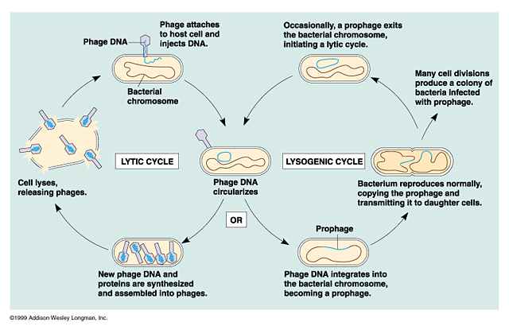
LYSOGENIC CYCLE

Slide 10
LYSOGENIC CYCLE
Host cell is not immediately destroyed, viral DNA becomes part of host cell’s DNA
ATTACH – attach to host cell
ENTRY – insert genetic material
INTEGRATION – viral DNA becomes part of host’s genetic makeup; “prophage” – does not interfere with normal functioning of host cell
REPRODUCTION – viral DNA is produced each time the cell divides
EXIT – prophage “pops out” of host’s DNA
LYTIC CYCLE – goes through the rest of the lytic cycle… attachment, entry, replication, assembly, lyses & release

Slide 11
Viral Diseases
Cold Sores/Herpes Simplex Virus (Lysogenic Cycle)
When virus “pops out”, you get a sore
HIV (retrovirus)
Works by producing a small number of viruses each time it reproduces
As long as cells are producing only a small amt, the person/host may not show symptoms for a while
This shows why most people who have HIV develop AIDS
As more cells become infected & viruses enter Lytic Cyle, WBCs are killed
Eventually the body’s immune system breaks down & can no longer fight off disease

Slide 12
KINGDOM MONERA
The Prokaryotes

Slide 13
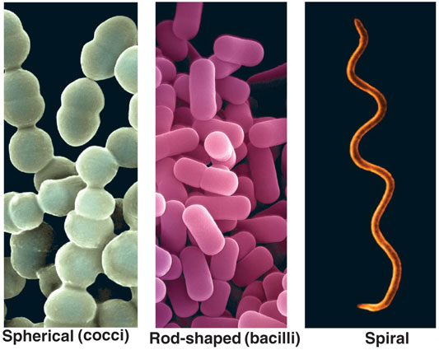
Most numerous & widespread organisms
Only kingdom of prokaryotes
Have a cell wall of peptidoglycan
Structural molecule NOT found in eukaryotes
Notes:
Combine Kingdom Archae and Eubacteria = Monera

Slide 14
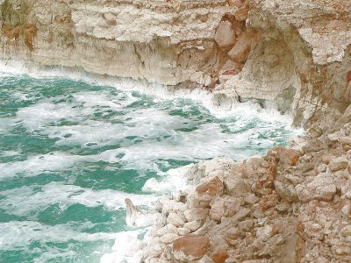
ARCHAEBACTERIA
Most ancient of all living things
3 types
1. Thermoacidophile
Extremely hot & acidic water
Moist areas in and around sulfur hot springs
Die of cold at temps of 55C!! = ?F
2. Methanogens
Obligate anaerobes (free Oxygen kills them)
10 known species
Use CO2 to produce methane (CH4) as waste
Exist in diverse environments
From scalding volcanic deep-sea vents to intestines of mammals…
* this is why you can light a puff of flatulence*
3. Halophiles
Extremely salty conditions
Pink pigments = conspicuous in large amounts
Dead Sea and Great Salt Lake

Slide 15
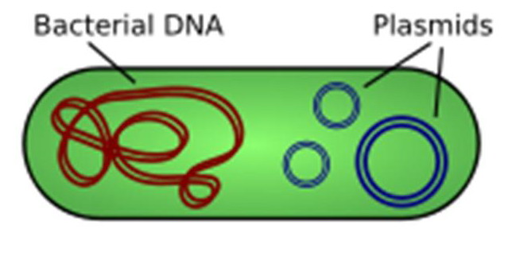
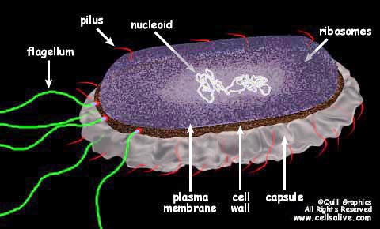
EUBACTERIA
Morphology
Shape, size, appearance
Lack membrane-bound nuclei
DNA forms a looped-tangle (“nucleoid”), but no membrane surrounds it
Contain small loops of DNA (“plasmids”) which can be transmitted from one bacteria to another
Transmitted through conjugation (sexual reproduction) or viruses
Makes bacteria amazingly adaptable!
Beneficial genes may spread rapidly through a bacterial population

Slide 16
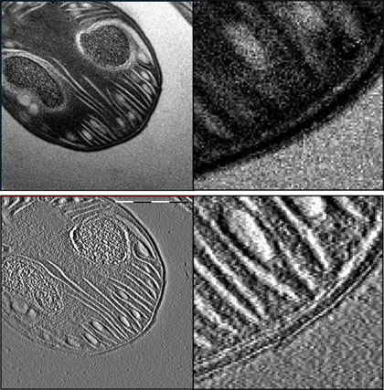
Eubacteria cont…
No membrane-bound organelles
Photosynthetic bacteria (ex “cyanobacteria”) may be filled with tightly packed inner folds of the outer membrane
Increases potential surface area for photosynthesis
Cell membrane surrounded by a cell wall
*except in one group! = mollicutes/mycoplasmas
Composition of cell wall varies
Important tool for identification/classification

Slide 17
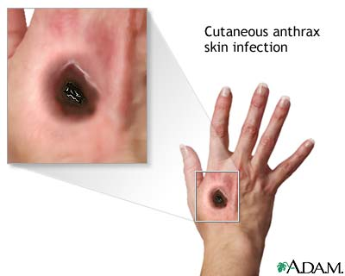
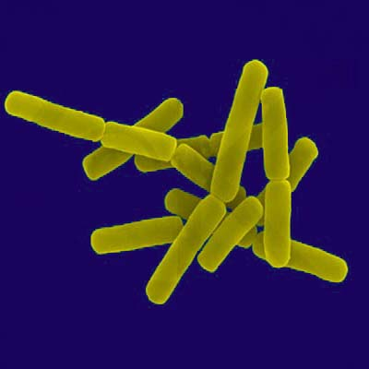
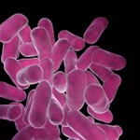
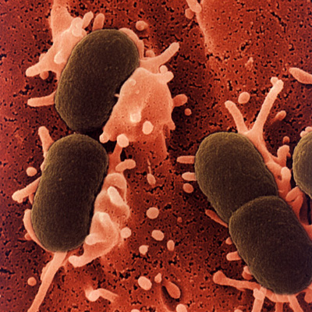
SHAPES - important identification & classification tool
3 Basic Types
1. Bacilli (singular = bacillus)
Rod-shaped
Most common
Escherichia coli that lives in your intestines
Lactobacillus spp. = tooth decay, yogurt
Bacillus anthracis = anthrax in sheep, cattle, and humans

Slide 18
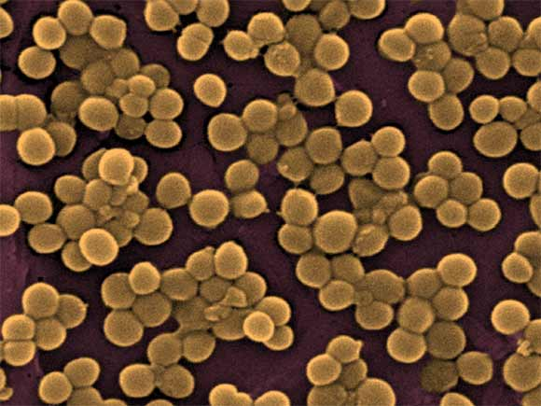
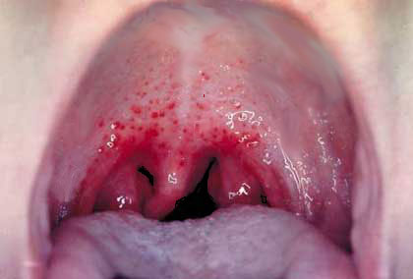
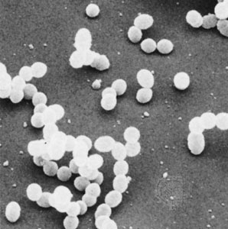
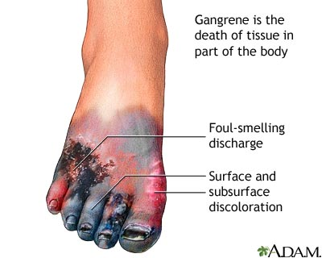
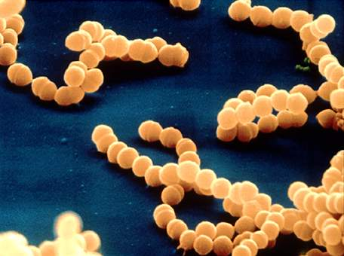
SHAPES cont…
COCCI (singular = coccus)
Spherical
Very common
Streptococcus spp = strep throat
“Strepto” = chain
Staphylococcus spp = gangrene in untreated wounds
“staphylo” = cluster

Slide 19
SHAPES cont…
3. Spirilla or spirochete (singular = spirillum)
Spiral-shaped
Largest in size & easiest to identify
Treponema pallidum – causes syphilis

Slide 20
Gram Staining

Slide 21
Gram Stain Procedure
Developed by Danish physician Hans Christian Gram in 1884
Most widespread method of bacterial classification
Identifies content of bacterial cell wall

Slide 22
Gram Stain Procedure
1. fix smear of bacteria to a slide
2. Primary Stain = flood slide with Crystal Violet for 10 sec. (wash with water)
3. Mordant = flood with Gram’s Iodine for 10 sec. (wash with water)
4. Decolorizer = 95% ethanol/ethyl alcohol (wash with water)
5. Secondary Stain = Flood with Safranin(pink) for 10 sec. (wash with water)
6. Air dry
7. Focus under light microscope to view outcome of bacterial appearance

Slide 23
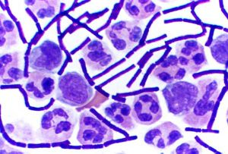
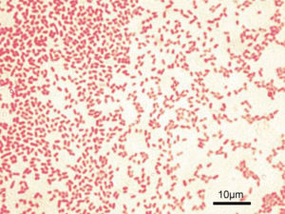
2 Types of Cell Walls
1. Gram Negative (G-)
Appear bright pink/red
2ND membrane around cell wall made of Lypopolysaccharide (LPS)
Crystal Violet can’t penetrate LPS & is washed away with ethanol
75% of known bacteria G-
Include rickettsias, chlamydias, and photosynthetic bacteria
2. Gram Positive (G+)
Appear purple/brown
Membrane rich in peptidoglycan, attracts Crystal Violet
No LPS layer
All bacillus

Slide 24
Cell wall characteristics are related to disease-causing potential
Effective way to fight bacteria is by interfering with cell wall formation
b/c eukaryotic cell walls and membranes don’t have similar chemical makeups to prokaryotes, the medicines used have no effect on the eukaryotic (plant or animal) cell

Slide 25
LOCOMOTION
Squirm, glide, propulsion
Flagella is different from those in eukaryotic cell
Composed of protein (“flagellin”) not found in eukaryotes
Rotates to propel organism instead of whip-like as in eukaryotes.

Slide 26
REPRODUCTION
Conjugation
Form of sexual reproduction
Swapping genetic information (plasmids)
Binary Fission
Bacteria reproduce this way mostly
Don’t go through mitosis b/c of DNA structure
1. circular DNA is replicated
2. cell splits into 2 identical cells each with same exact copy of DNA

Slide 27
MYCOPLASMAS
Smallest living thing discovered
Minimum amt. of DNA for fxn cell
no cell wall
Intracellular plant or animal parasites
Protects them from changes in environmental & water pressures
Penicillin (kills most bacteria by interfering with cell wall fxn) doesn’t work against Mycoplasmas because they don’t have a cell wall!

Slide 28
Bacteria & Humans
1. Human microbiota (or “flora”) – microbial inhabitants of the human host
About ½ of cells are bacterial cells
Resident microbiota – form stable relationships with us
Transient microbiota – just passing through
Include Opportunistic Pathogens (cause disease if given the chance)

Slide 29
2. Where does the microbiota come from?
Fetus is sterile (or nearly)
Newborn picks up some bacteria in birth canal, most others in hospital
Newborn flora resembles that of sick adult (rapidly multiplying)
By 2 years, microbiota relationship matures to resemble adult ecosystem

Slide 30
3. What is resident microbiota good for?
Symbiosis = general term for association b/w microbes & us
Mutualism → both us & bacteria benefit
Commensalism → microbe benefits w/o helping or harming us
Parasitism → microbe benefits & harms us
EXAMPLES of mutualism
Immunoprotection: providing antigens that help ward off later infections
Vitamin absorption
Commensalism can become parasitism due to changes in location

Slide 31
4. Where the microbiota is (and isn’t)
Bacteria are NOT found (in healthy humans)…
Blood: called bacteremia, blood poisoning, or septicemia
Cerebrospinal fluid (CSF): tissue surrounding brain & spinal chord… called Meningitis
Tissues
Lungs → pneumonia
Heart → endocarditis
Brain → encephalitis
Where bacteria are (every exposed area)
Skin
Nasal area
Eyes & ears
Alimentary canal (mouth to anus) and genitourinary tract

Slide 32
5. What we do to keep out transients
Nature of mucosal surface

