Slide 1
KINGDOM PROTISTA

Slide 2
GENERAL
More complex than monerans (bacteria)
Eukaryotic
Grouped by overall characteristics →
  Animal-like, plant-like, and fungus-like

Slide 3
PROTOZOANS (animal-like)
Unicellular heterotrophs
Grouped by the way the move or don’t move
  Pseudopodia, cilia, flagella, or non-motile

Slide 4
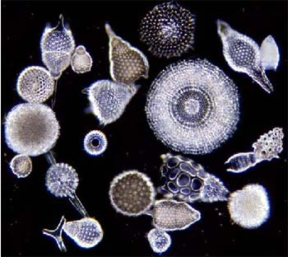
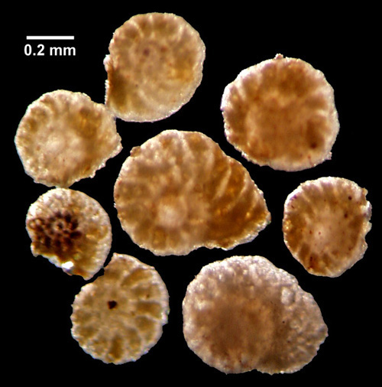
Phylum Rhyzopoda
(Sarcodina = amoebas)
Move by pseudopodia (“false feet”)
  Extensions of the cytoplasm
Freshwater & marine environments
Foraminifera = shells made of CaCO₃ – Calcium Carbonate
Radiolaria = shells made of silica
Reproduction
  Asexual
  If conditions are not good (ie drought) cyst forms
    Amoebic dysentery = severe watery diarrhea – dehydration, is caused by a cyst-forming amoeba (Entamoeba hystolytica)

Slide 5
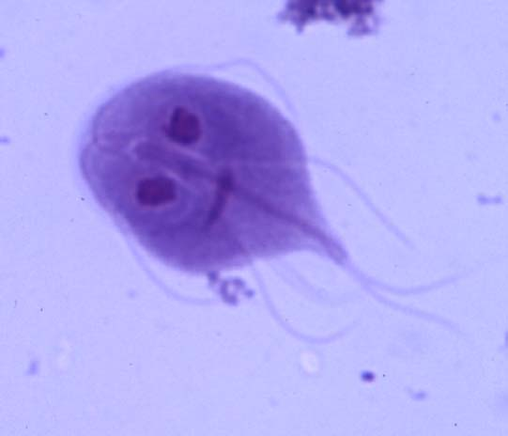
Phylum Zoomastigina
(flagellates)
Move by flagella (whip-like)
Mostly parasitic & cause disease in animals
Some mutualistic! = live in guts of termites
  Digest cellulose in wood which helps both the protist & the termite

Slide 6
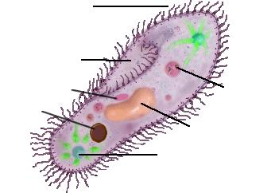
Phylum Ciliophora
(ciliates)
CILIA
Move by synchronized beating of cilia
Paramecium structures
  Anal pore = waste removal
  Cilia = movement
  Micronucleus = sexual reproduction
  Macronucleus = everyday functions
  Contractile vacuole = eliminates excess H₂O
  Oral groove = sweep food into gullet
  Gullet = contains digestive enzymes
ORAL GROOVE
MICRONUCLEUS
ANAL PORE
MACRONUCLEUS
CONTRACTILE VACUOLE
REPRODUCTION
- asexual = division
- sexual = conjugation

Slide 7
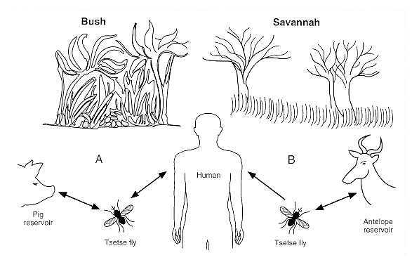
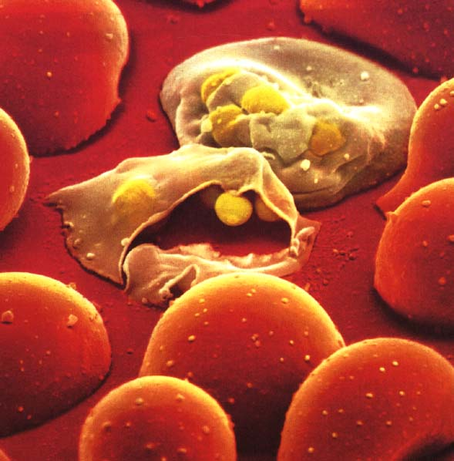
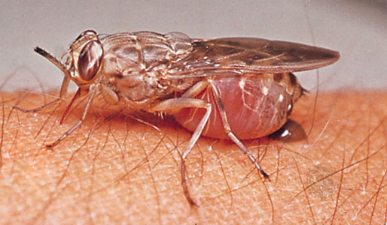
Phylum Sporozoa
(spore forming protists)
Parasitic; non-motile
Reproduction – form spores
Examples:
  Plasmodium vivax = spread by the female Anopheles mosquito; causes malaria
  Trypanosoma rex = spread by Tsetse fly; causes African Sleeping Sickness
  Giardia lamblia = spread by contaminated drinking water; causes explosive diarrhea; is actually a flagellate! Was once thought to be sporozoa because of cysts

Slide 8
ALGAE
PLANT-LIKE PROTISTS

Slide 9
What are algae?
Photosynthetic protists (autotrophs!)
Range in size → unicellular to multicellular
No defined tissues (roots, stems, or leaves)
Classified by their pigments
Base of food chain; major source of Earth’s:
  Nutrients
  Oxygen! (produces about 75% O₂ )

Slide 10
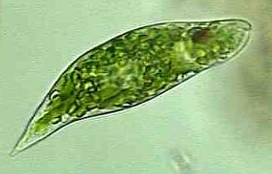
Phylum Euglenophyta
(Euglenoids)
Unicellular, aquatic
Plant-like; have chlorophyll
Animal-like; move & can consume food if no light available

Slide 11
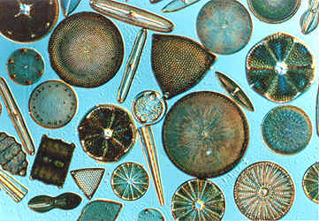
Phylum Bacillariophyta
(Diatoms)
Unicellular; aquatic
Grouped by shape
  Radial symmetry = no distinct right or left sides
  Bilateral symmetry = distinct right & left sides (like humans)
Shells
  Made of silica
  2 halves fit together like a box & lid
  Very intricate decorations (swirls & grooves)

Slide 12
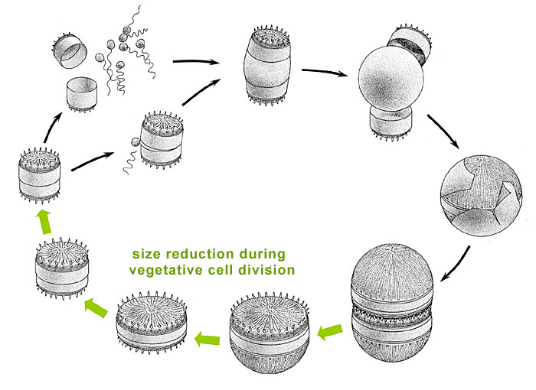
Diatoms cont…
Reproduction
  Asexual
    Each ½ produces a new ½
    When they reach about ¼ of adult size → sexual reproduction
  Sexual
    Gametes (sex cells) are produced
    Fuse with another to form a zygote (diploid)
    Zygote grows to full-sized diatom
Pigments
  Chlorophyll plus carotenoid = golden/yellow color
  Ocean sediments contain huge quantities; used for polishes & added to highway paint!

Slide 13
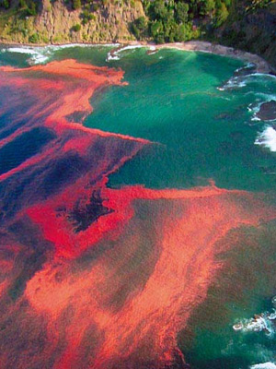
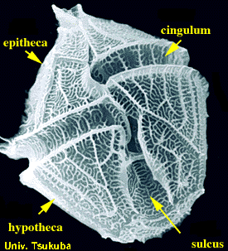
Phylum Pyrrophyta
(Dinoflagellates = spinning algae)
Unicellular; aquatic
Cell walls = thick cellulose plates
Resembles helmets/suit of armor
Move by 2 flagella that spin in grooves
Important example = Red Tide!
  Huge quantities of algae produce toxin that kills fish and contaminates shellfish → can make people who eat them very sick

Slide 14
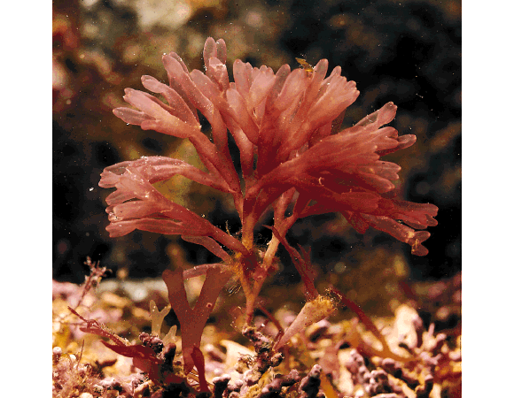
Phylum Rhodophyta
(Red Algae)
Multicellular; marine
Adaptations
  Attach to rocks by holdfasts (look like roots but they aren’t)
  Red pigment (phycoerythrin) allows them to grow very deep in oceans

Slide 15
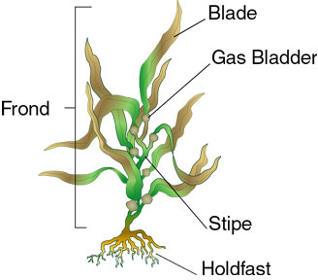
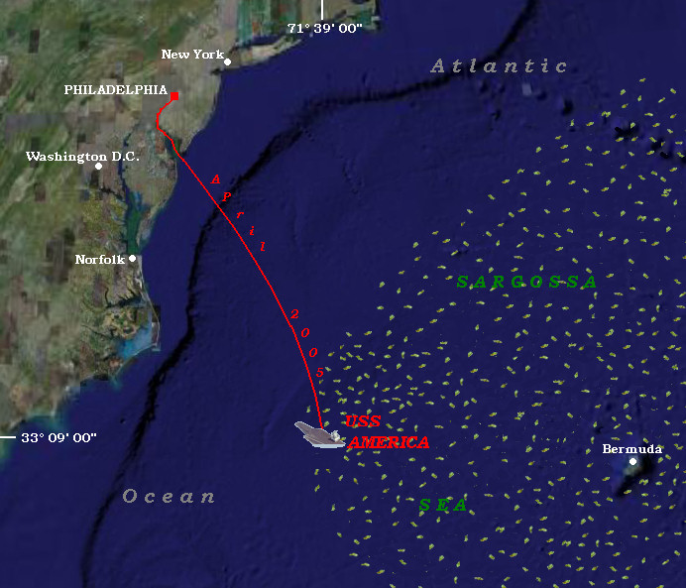
Phylum Phaeophyta
(Brown Algae)
Multicellular; marine
Brown pigment (fucoxanthin)
Important Example = Kelp!
Thallus – simple plant body without roots, stems, or leaves
Can be very long (60 meters = ____ ft)
Holdfasts, stipe, blade, and air bladders (hold large body up toward light)
Forms underwater forests
Example = Sargasso
  Forms extensive mass that covers Sargasso Sea in Atlantic

Slide 16
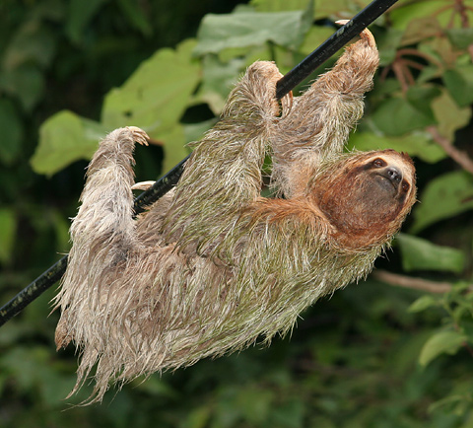
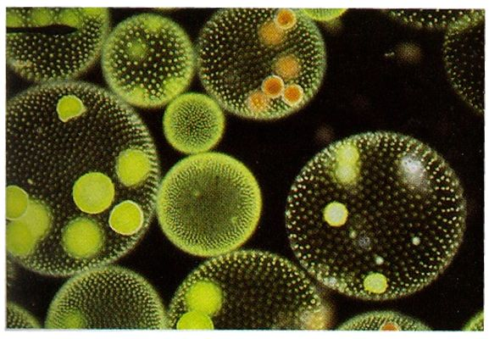
Phylum Chlorophyta
(Green Algae)
Multicellular; chlorophyll
Most diverse phylum!
Habitats:
  Freshwater
  Soil
  Snow
  Sloth fur!
Some form colonies = groups of cells that live in close association
  Example Volvox

Slide 17
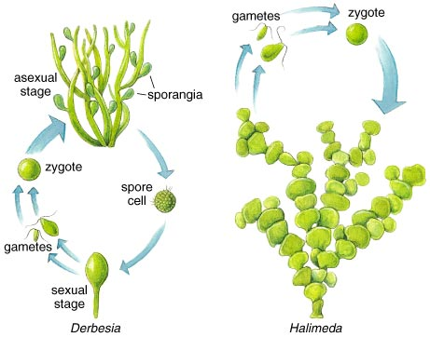
Reproduction of Algae
Asexual = fragmentation
  Breaks into pieces & each piece grows into a full algae
Alternating Generations
  Haploid Generation = gametophyte
    Makes gametes
  Diploid Generation = sporophyte
    Makes genetically unique diploid generation

Slide 18
FUNGUS-LIKE PROTISTS
Have characteristics of both plant-like and animal-like protists

Slide 19
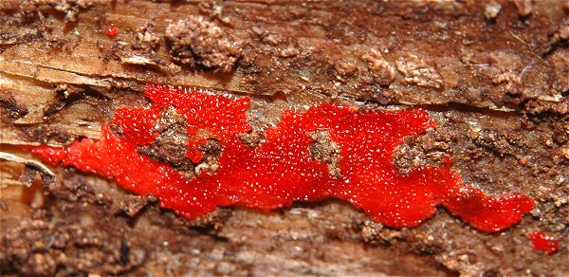
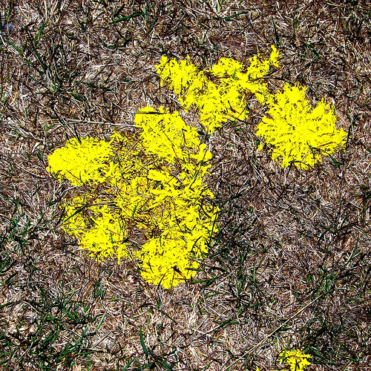
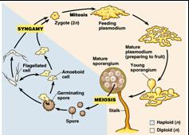
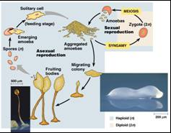
Slime Molds
2 Phyla
  Myxomycota = acellular
  Acrasiomycota = cellular
At some point in their life cycle, they are amoeba-like, have flagella, and produce spores!
Live in cool, shady areas
Grow on damp organic matter (like decaying leaves)

Slide 20
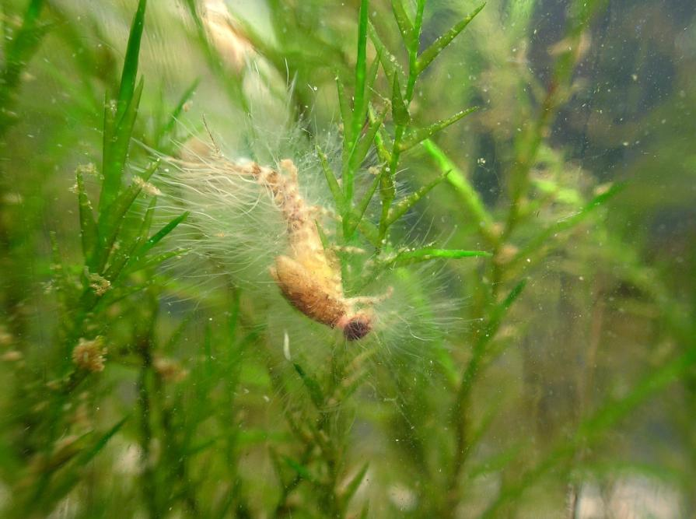
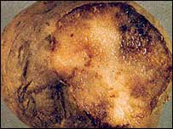
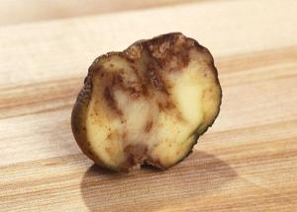
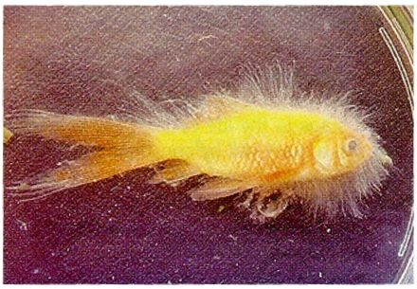
MILDEW & WATER MOLDS
Phylum Oomycota
Some are plant parasites; others feed on dead organisms (saprophytes)
Parasites on live fish & fish eggs
Generally live in H₂O & have cell walls of cellulose
Responsible for economically disastrous diseases in plants
  Irish Potato Famine was caused by a member of this phylum… killed 1.5 million people in the 1840’s!!!

