Slide 1
MudBugs | Night-crawlers | When I grow up | Terms | Classification | My Parts
A | A | A | A | A | A
B | B | B | B | B | B
C | C | C | C | C | C
d | d | d | d | d | d
e | e | e | e | e | e

Slide 2
Which structure is used for defense and food handling?

Slide 3
CHELIPED

Slide 4
Where are the gills of the crayfish located?

Slide 5
Top of the walking legs

Slide 6
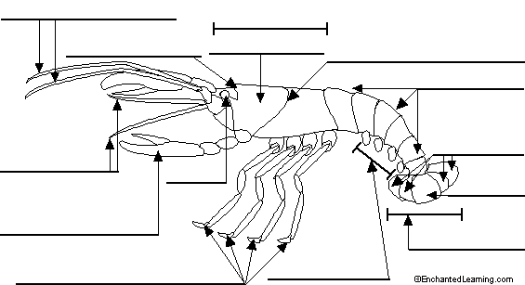
Which structure is A ?
A

Slide 7
Telson

Slide 8
Which structure is B ?
B

Slide 9
Cephalic Groove

Slide 10
Which structure is C ?
C

Slide 11
Rostrum

Slide 12
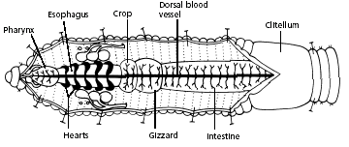
Which structure is D ?
D

Slide 13
Dorsal Blood Vessel

Slide 14
Which structure is E ?
E

Slide 15
Clitellum

Slide 16
Which is the function of “F”?
F

Slide 17
Grind soil

Slide 18
Which is the function of “G”?
G

Slide 19
Pump blood

Slide 20
What is the structure labeled “H”?
H

Slide 21
Intestine

Slide 22
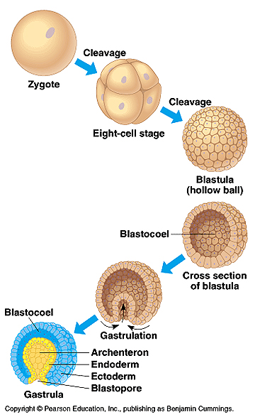
I
The image labeled “I” is of a diploid cell that forms when the sperm and egg unite. What is this diploid cell called?

Slide 23
Zygote

Slide 24
The images labeled “J” are of a hollow ball of cells that has formed after the zygote has divided. What is this hollow ball of cells called ?
J

Slide 25
Blastula

Slide 26
The images labeled “K” are formed by the blastula folding in on itself and creating 2 layers. What is this 2-layered stage of animal development called ?
K

Slide 27
Gastrula

Slide 28
DAILY DOUBLE
You may bet up to
2 points over your
current total

Slide 29
The image labeled “L” is called the Blastopore.
What structure does the blastopore become in deuterostomes like humans?
L

Slide 30
Anus

Slide 31
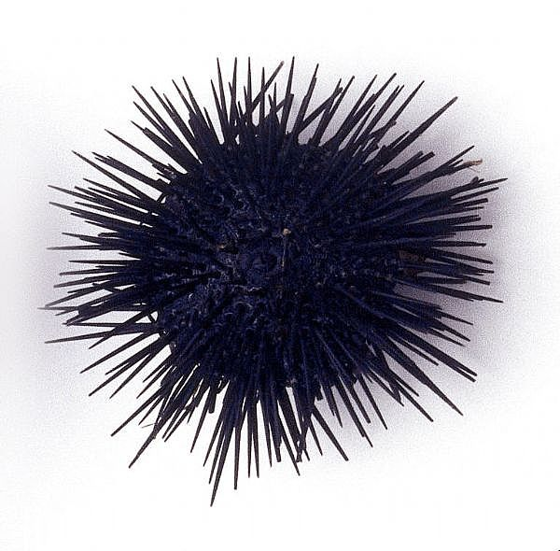
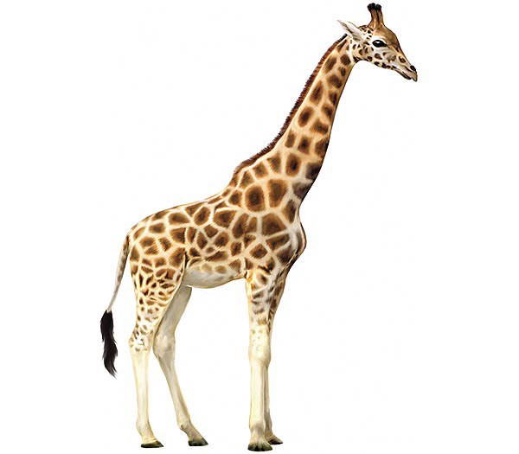
Which of the animals shown would have bilateral symmetry?
Urchin Giraffe

Slide 32
giraffe

Slide 33
Which term is defined as a tube-shaped body with a mouth surrounded by tentacles and
is the asexually reproductive stage of Phylum Cnidaria?

Slide 34
POLYP

Slide 35
Which term refers to the body sections of tapeworms that are full of eggs?

Slide 36
PROGLOTTIDS

Slide 37
Which term refers to the inside layer of cells of the gastrula that gives rise to digestive tissue?

Slide 38
endoderm

Slide 39
Which term refers to the type of circulatory system in which the blood is not carried in vessels, instead, it flows freely over the internal organs and tissues?

Slide 40
open

Slide 41
DAILY DOUBLE
You may bet up to
2 points over your
current total

Slide 42
Which term refers to the 2ND pair of appendages of a spider that are adapted for sensory functions and handling food?

Slide 43
Pedipalps

Slide 44
All arthropods have jointed appendages and an exoskeleton; however, spiders and ticks also have a booklung for respiration. Their classification includes:
Kingdom Animalia
Phylum Arthropoda
Class ______?_______

Slide 45
Arachnida

Slide 46
Centipedes are different from Millipedes in that they are carnivorous and have only one pair of legs per body segment. Their classification includes:
Kingdom Animalia
Phylum Arthropoda
Class ______?_______

Slide 47
Chilipoda

Slide 48
Sponges are the only animals that do not form a gastrula during development. They are filter feeders who remain sessile in their adult stage. Their classification is:
Kingdom Animalia
Phylum ______?_______

Slide 49
Porifera

Slide 50
Our first dissection was of an earthworm which has the scientific name Lumbricus terrestris.
Their classification is:
Kingdom Animalia
Phylum ______?_______

Slide 51
Annelida

Slide 52
Humans, lancelets and sea squirts all have gill slits, a dorsal nerve cord, bilateral symmetry, and muscle blocks. Their common classification is:
Kingdom Animalia
Phylum ______?_______

Slide 53
Chordata

Slide 54
Some members of Class Insecta (“insects”) such as caterpillars to butterflies go through complete metamorphosis. What are the stages IN ORDER of complete metamorphosis?

Slide 55
Egg
Larvae
Pupa
Adult

Slide 56
Many lower animals have the ability to produce viable eggs and sperm. What is this term?

Slide 57
Hermaphrodite

Slide 58
Animals with an exoskeleton contract their posterior muscles to force blood forward. This causes the anterior region to swell and the old exoskeleton splits. The animal then crawls out while its new exoskeleton dries and hardens.
WHAT IS THIS PROCESS CALLED?

Slide 59
Molting

Slide 60
There are many adaptations to respiratory structures and this especially can be seen when studying Arthropods.
What type of respiratory structure to centipedes and millipedes have?

Slide 61
Tracheal Tubes

Slide 62
Some animals with bilateral symmetry will have a 3RD cell layer during development. This 3RD cell layer eventually becomes a true body cavity that is surrounded by and attached to mesoderm tissue.
WHAT IS A TRUE BODY CAVITY CALLED?

Slide 63
COELOM

